Slide 1
KHALSA

Slide 2
When we say the word ‘Khalsa’…
What image do you have in your head?
What characteristics are there of a Khalsa?
Do we really need the Khalsa now, in these times?
Is this what our Gurus imagined?
Notes:
Masculine – kesh – bana. Shastra kirpan…warrior. was more to the character of
a Khalsa? One who stands up for justice?
Lets look in detail we can easily

Slide 3
Example of a Khalsa
Bhai Taru Singh’s tragic death is put before us in words of blood, but his inner life has yet to be told in its life-streams of the milk of devotion to the present day Sikhs, for he lived even more nobly than he died.
Immersed in the flowing Ganga of Naam, living in his village hut, tilling the soil and growing grain, unknown to the world outside, being a simple Sikh, yet a man of tremendous devotional power in the guise of a simple ploughman.
Bhai Taru Singh is forever the true type of the Khalsa, one devoted to the Name and one in many and many in one.
Such was the miracle of the presence of Guru Gobind Singh in the heart of the humble disciple. E- Mata Tar Kaur

Slide 4
Professor Puran Singh on the Khalsa
Those whom Guru Gobind Singh praises in such glowing terms and for whom He melts away in supreme emotion on many occasions, they alone can compose the Sikh Sangat, the Khalsa.
It is the Assembly of “Guru Gobind Singhs” as all bodies of His Sikhs, the disciples, are only the vehicle of His spirit.
The majesty and spiritual splendour of this ideal group of “Guru Gobind Singhs”, which had been the dream of Guru Nanak, and which Guru Gobind Singh named “Khalsa” is but the root of the kingdom of Righteousness planted in the garden of Anandpur.
Angels and gods of Heaven walked in His shape in the wild forests of liberty. This was the Khalsa, the chosen, the Glorious, the myriad forms of the one Guru Gobind Singh!
Spirit of the Sikh

Slide 5
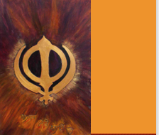
Who created the Khalsa?
Khalsa was created by His Will
p.291 AK

Slide 6
Khalsa Akal Purakh Kee Fauj
The Khalsa was created out of the will and happiness of that immortal being.
The Divine Oneness was/is the Creator of the Khalsa.
Guru Nanak dev ji initiated the process of training us how to be a Khalsa .
Guru Gobind Singh ji finalized and formalized the Khalsa
(the mentality of the Khalsa).
What was the reason for Guru Saab to create such a strong army?
Notes:
Guru's lived during the reign of Mughal invasion and there was a lot of oppression so in order to create social uprising in order to galvanize ordinary

Slide 7
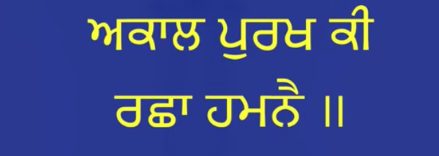
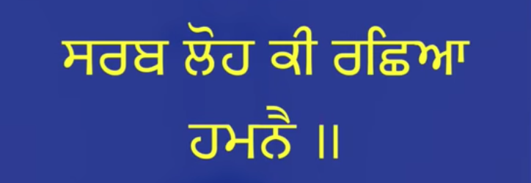
Why take Khandey dee Pahl?
The Amrit ceremony portrays deep symbolism begins with Sarab Loh batta (iron bowl)
The words Sarab Loh means Akal Purakh . In Dasam Granth (Akal Ustat) Guru ji calls for :
The All pervading God is My Protector The All- Steel Lord is my protector
Sarab means All pervading - Loh means light - Amrit is created in a vessel of Divine Light
Notes:
Kaur Princess – self sovereighnty - Guru ji gives us a connection with the divine directly answerable to the divine . Guruji wanted to take ordinary people and transform their character both socially and spiritually.
Khlasa is a revolutionary – how does this transformation occur?
-- turbans

Slide 8
Khanda
Khanda - a double edged sword.
Guru ji uses some fantastic psychology - he gives us a connection with the sword.
Guru ji says this isn't just any ordinary sword but the energy of Akal Purakh
calling it bhaguatee (Chandi dee vaar)- the energy of the sword.
I seek the protection of that Shakti that power of the sword
Dasam Granth
Ang 244
Notes:
what else goes into the ceremony
How do you get ordinary folks to use a sword of course there is the training that's involved but how do
you get over the mentality that ordinary people don't know how to use a sword
Part of the change of the character (transformation) is that ordinary farmers and traders were told to replace their tools with swords.

Slide 9
So first the Sarab Loh -the Creative Force, and then the Khanda-the creative power
In the beginning I remember bhagauti, the Lord - whose symbol is the sword
and then I remember Guru Nanak.
Dasam Granth Ang. 244

Slide 10
“Jai Tegham! Jai Tegham”
COLOURED CRIMSON
The Khalsa is thus coloured Crimson
with soul of Guru Gobind Singh who,
with the jealousy of a true artist
who has to undergo so much travail
for the birth of a new idea,
bade his disciples salute God with the Naked Sword,
and guard jealously with the heroic prowess
the seed of Truth that he had sown in the fields of their souls.
Spirit Of the Sikh
Prof Puran Singh

Slide 11
Prof. Puran Singh continues to say:
Guru ji invokes the protection of Kal Kirpan, the “Time Sword” or the “Death Sword” for protection of the ideal of the Khalsa embodied in human clay.
And by putting a sword in the hand of every slave in Punjab, he makes him a free man by one draught of His sword-stirred, Word-born water of Simrin, Naam.
Such is Guru Gobind Singh.

Slide 12
What happens if you're initiated with a ceremony that is of that Khanda?
What happens when you get handed that Khanda in your hand ?
All of a sudden you now realize this isn't just any old weapon- this is the energy of the Divine Being, so we are the warriors of the divine.
We are initiated with the divine and we are holding the power of the divine - we're the Warriors of Light, so of course we can fight anything and anyone.
Look at the symbolism we've seen so far:
The sword is the strength of mind that we need to uphold the spiritual values.
Notes:
. you see the psychology guru ji is using now all – khalsa soee jo nit kare jung

Slide 13
The next two ingredients …
Water
Water is clean, pure so while you might be strong on the outside you have to be still, stable, calm and neutral on the inside.
Water is pure until there is some impurity that's put in there.
Patasha
So that we use our sword with love, sweetness and kindness.
This is represented by the sugar dissolved into the water.

Slide 14
This Universe is the Body Divine of God
The Khalsa has no selfish ends for the aggrandisement of his small self in this warfare of life, because his:
“I” has already grown by the Grace of the Guru to be large “I” of Humanity itself.
He is God.
No one need be afraid of the Khalsa of Guru Gobind Singh.
The eyes of the Khalsa are fixed heavenward.
“I opened my eyes and saw that this Universe is the body divine of God;
it is Beauty of Hari, Hari!”
Guru Granth (Ramkali, Anand, XXXVI)

Slide 15
The Khalsa is Dead to the World
The Khalsa has no time for the miserable details of the humdrum mundane world.
All that the world holds precious has dropped form his hands, as he lies dead to it - in God!
All acts that come from an elevated consciousness are of the glorious choice of freed souls.
Notes:
Maharaja Ranjit Singh cried like a bond slave of love, when an embroidered canopy with diamond pendants was spread over him.
“Ah! no, I am not the King. I am His slave.”
The canopy was sent to the Golden Temple, to the Guru, the true sovereign

Slide 16
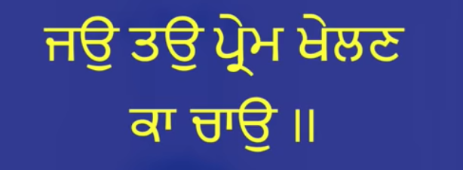
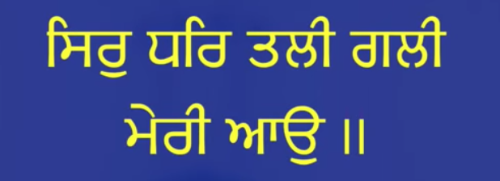
What are the qualities that a person needs to receive Amrit?
If you desire to play this game of love with me,
Then step into my path with your head in your hand
Dasam Granth ang 244
Notes:
Maharaja Ranjit Singh cried like a bond slave of love, when an embroidered canopy with diamond pendants was spread over him.
“Ah! no, I am not the King. I am His slave.”
The canopy was sent to the Golden Temple, to the Guru, the true sovereign

Slide 17
In order to walk the spiritual path, you must give up your head
In other words you must:
Give up your identity
Give up your selfishness
Give up your ego
Have the mentality of self-restraint, discipline, self-control, patience and a receptive mind
This is the transformation that is required to become THE KHALSA!

Slide 18
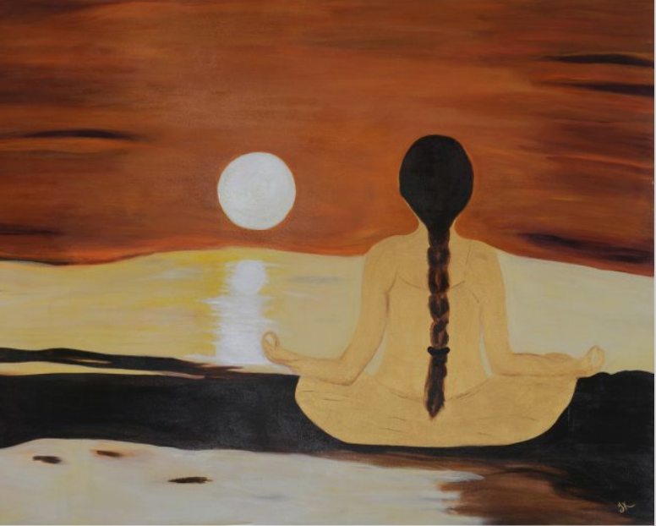
sB ikCu Gr mih bwhir nwhI ]
bwhir tolY so Brim BulwhI ]
Everything is within the home of the self; there is nothing beyond.
One who searches outside is deluded with doubt
Guru Arjan Dev Ang 102

Slide 19
The external Amrit helps us to find the Internal Amrit
“Spiritual practice is a ripening experience, it's not a learning experience. We are like fruits and through practice we expose ourselves to the sun of love." -Krishna Das
The initiate sees in the heart of the Khalsa the Guru Himself enthroned.
The Khalsa are dear not for their physical relics, for all bodies are clay, but for the holy image of the Guru they carry in their being!
For a moment when the Guru visits the heart-mansions of the Initiates, the latter are transformed into the glorious Khalsa!!
Notes:
Jaag

Slide 20
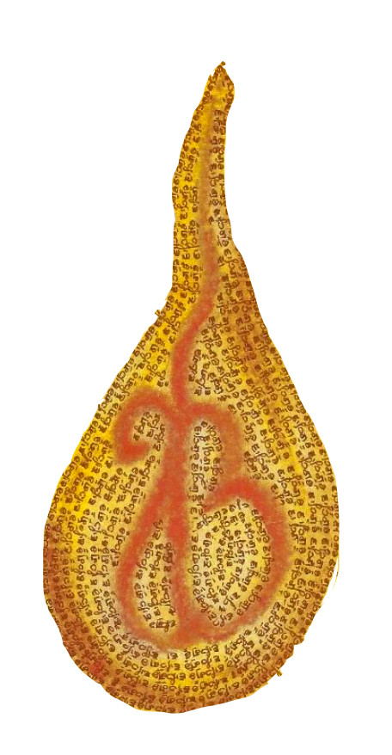
THE LAMP OF MAN
“He in whose Heart burns flickering the Lamp of Naam, day and night, Know him the Khalsa, the pure!”
Such an individual is a million in Himself, and has the strength of millions.
The Khalsa-has the infinite abundance of Heaven at his back.
Nothing is lacking in him.
The Guru from his great Treasure of Love grants him everything.” Professor Puran Singh
Notes:
uru Gobind Singh sings passionately of the Khalsa again-

Slide 21
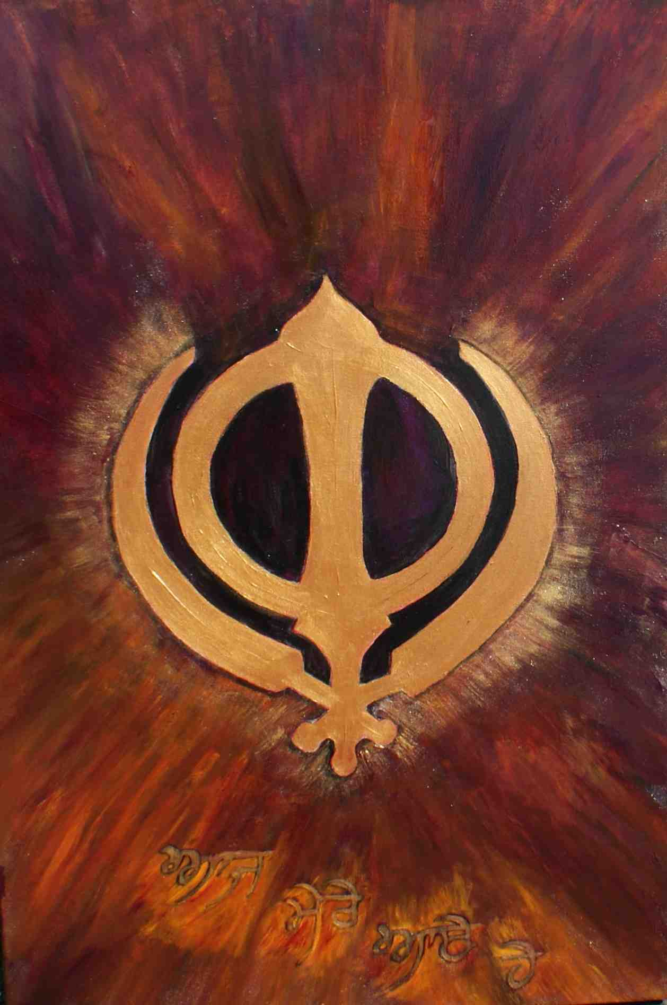
Who is the Khalsa?
Says Kabeer, those humble people become pure –
they become Khalsa –
who know the Lord's loving devotional worship.
Ang 654

Slide 22
THE ELOQUENT SILENCE
Be quiet and only live.
The life of Naam itself is the greatest of all expressions.
Be!
Is being not the very essence of faith?
There is the Bowman!
Has the arrow pierced you?
Do not ask any more, begin a new life!
Enough, you are now his.
He is yours.
Spirit of the Sikh

